Slide 1
Architecture Evaluation
Evaluation Factors
Evaluation by the designer
Every time the designer makes a key design decision or completes a design milestone, then chosen and competing alternatives should be evaluated using the analysis techniques.
Evaluation by the designer is the “test” part of the “generate-and-test” approach to architecture design.
Considerations for evaluating architecture
The importance of the decision
The number of potential alternatives
Good enough as opposed to perfect
Evaluation by peers within the design process
A peer review can be carried out at any point of the design process where a candidate architecture exists.
Steps:
The reviewers determine a number of quality attribute scenarios to drive the review.
The architect presents the portion of the architecture to be evaluated.
For each scenario, the designer walks through the architecture and explains how the scenario is satisfied, and the reviewers ask questions to determine if the scenario is satisfied and its affect on other scenarios.
Potential problems are captured.

Slide 2
Architecture Evaluation
Evaluation Factors
Analysis by outsides once the architecture has been design
In principle, an outside team may evaluate a complete architecture, an incomplete architecture, or a portion of an architecture.
In practice, because engaging them is complicated and often expensive, they tend to be used to evaluate complete architectures.
Context factors
What artifacts are available
Who sees the results (private or public)
Who perform the evaluation
Which stakeholders will participate
What are the business goals

Slide 3
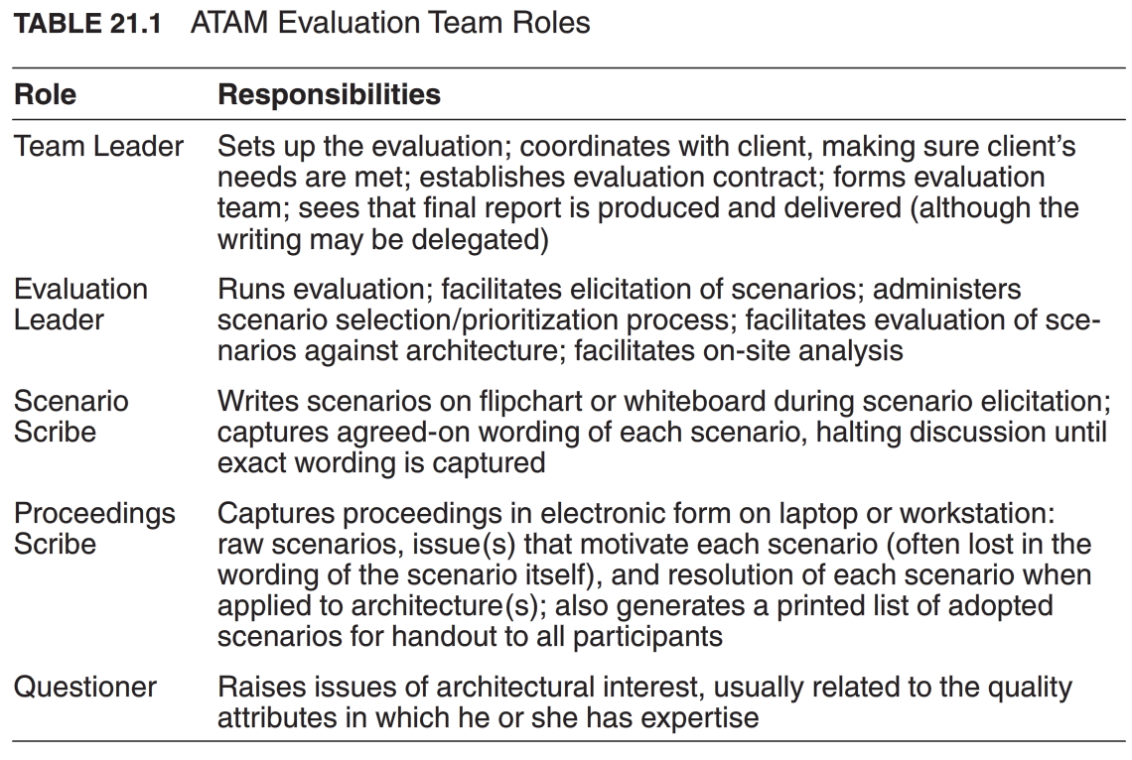
Architecture Evaluation
The Architecture Tradeoff Analysis Method (ATAM)
Participants in the ATAM
The evaluation team
Project decision makers
Architecture stakeholders (developers, testers, integrators, maintainers, performance engineers, users, builders of external systems which will communicate this system, etc.

Slide 4
Architecture Evaluation
The Architecture Tradeoff Analysis Method (ATAM)
Outputs of the ATAM
A concise presentation of the architecture
Articulation of the business goals
Prioritized quality attribute requirements expressed as quality attribute scenarios
A set of risks and nonrisks
Risk: an architectural decision that may lead to undesirable consequences in light of stated quality attribute requirements.
A set of risk themes
Risk themes: overarching themes that identify systemic weakness in the architecture or even the architecture process and team. If left untreated, these risk themes will threaten the project’s business goals.
Mapping of architectural decisions to quality attributes
A set of identified sensitivity and tradeoff points
Sensitivity point: decision made for this point in the architecture design will affect satisfaction of certain quality attribute(s).
Tradeoff point: tradeoff is needed when making decision to satisfy two or more quality attributes at this point in the architecture design.

Slide 5
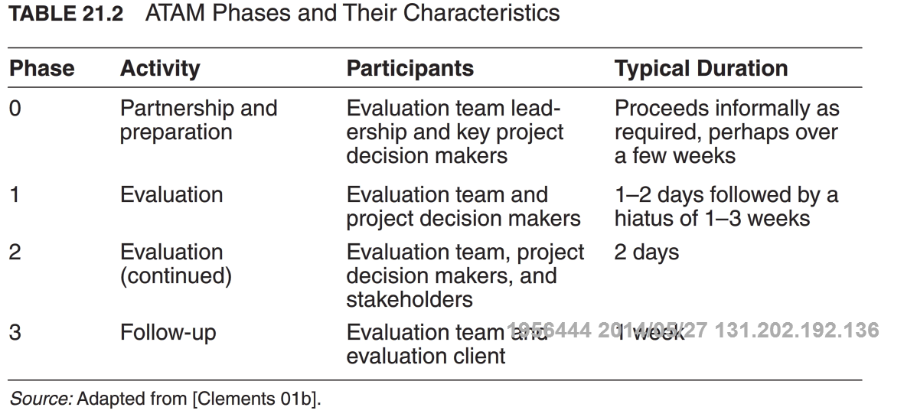
Architecture Evaluation
The Architecture Tradeoff Analysis Method (ATAM)
Phases of the ATAM

Slide 6
Architecture Evaluation
The Architecture Tradeoff Analysis Method (ATAM)
Steps of the evaluation phases
Step 1: Present the ATAM
Step 2: Present the business drivers
The system’s most important functions
Any relevant technical, managerial, economic, or political constraints
The business goals and context as they relate to the project
the major stakeholders
The architectural drivers or ASRs.
Step 3: Present the architecture
Context diagram
Module or layer view
Component-and-connector view
Deployment view
Architectural patterns and tactics employed and associated quality attributes
Use of reusable, commercial off-the-shelf (COTS) products
1-3 important use cases
1-3 important change scenarios
Architectural issues/risks with respect to meeting the driving architectural requirements

Slide 7
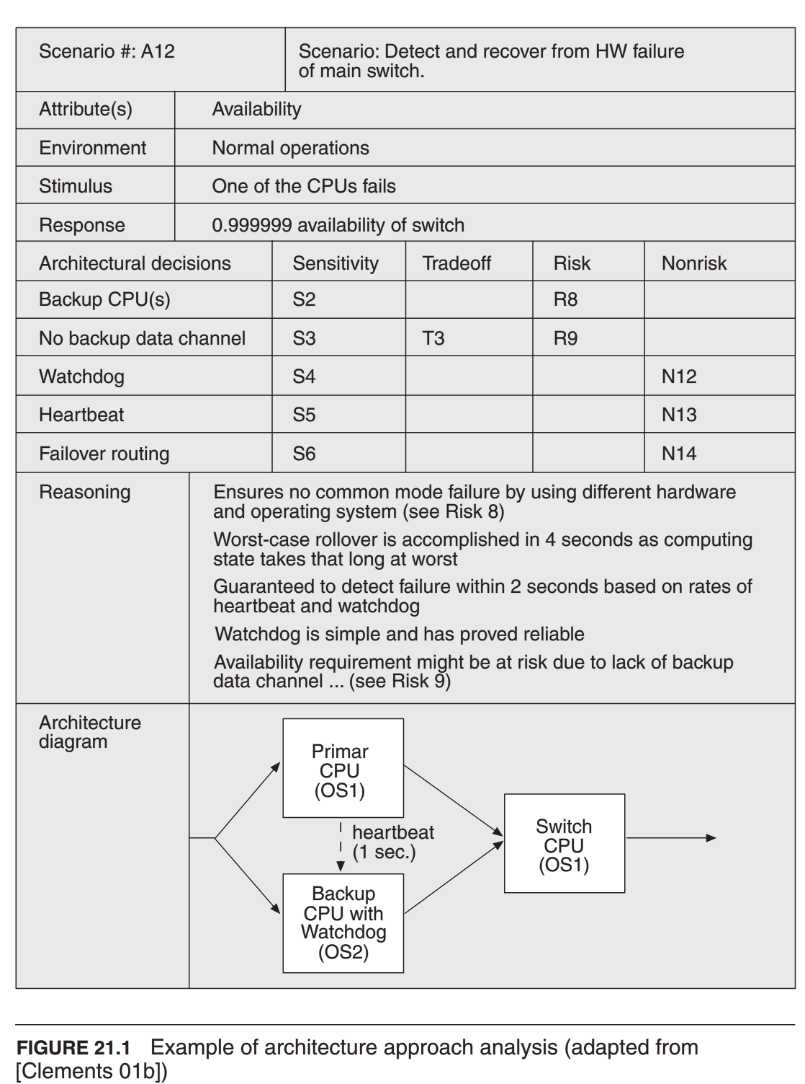
Architecture Evaluation
The Architecture Tradeoff Analysis Method (ATAM)
Steps of the evaluation phases
Step 4: Identify architecture approaches
catalog the patterns and tactics that have been identified.
Step 5: Generate quality attribute utility tree
Step 6: Analyze architectural approaches

Slide 8
Architecture Evaluation
The Architecture Tradeoff Analysis Method (ATAM)
Steps of the evaluation phases
Step 7: Brainstorm and prioritize scenarios
Step 8: Analyze architectural approaches (again)
After the scenarios have been collected and prioritized, the evaluation team guides the architect in the process of carrying out the highest ranked scenarios.
In this step, the evaluation team performs the same activities as in step 6, using the highest-ranked, newly generated scenarios.
Typically, this step might cover the top 5-10 scenarios as time permits.
Step 9: Present results
The evaluation team groups risks into risk themes, based on some common underlying concern or systemic deficiency.
For each risk theme, the evaluation team identifies which of the business drivers are affected.
The collected information from the evaluation is summarized and presented to stake holders:
The architectural approaches documented
The set of scenarios and their prioritization form the brainstorming
The utility tree
The risks discovered
The nonrisks documented
The sensitivity points and tradeoff points found
Rick themes and the business drivers threatened by each one

Slide 9
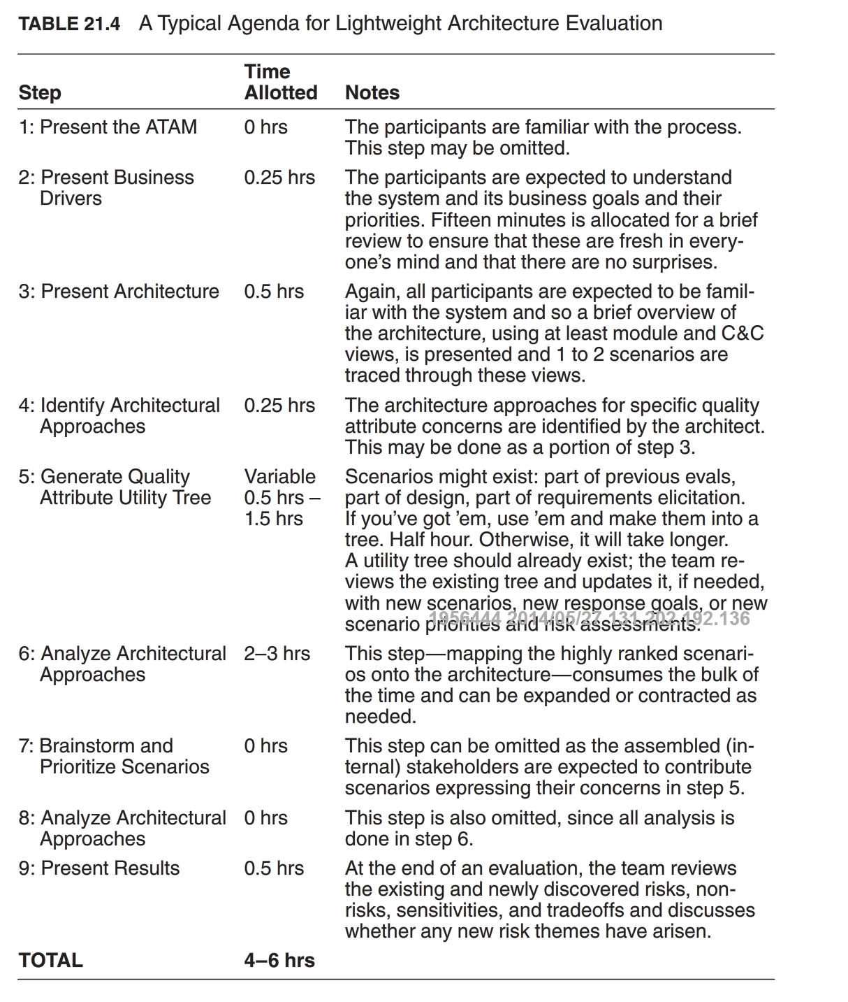
Architecture Evaluation
Lightweight Architecture Evaluation

